Slide 1

Helping your Kickstarter Campaign Reach its Goal
Emily Pfeifer
Module 3 Final Project

Slide 2
Top Classifiers
9 different models
Most Accurate: CatBoost, Random Forest with GridSearch, Adaboost
Predict success of campaign with 70-72% accuracy
Catboost consistently best
Notes:
*good that most of the classifiers performed around the same percentage (which was relatively high)
*there are tweaks to the data that could improve accuracy of model

Slide 3
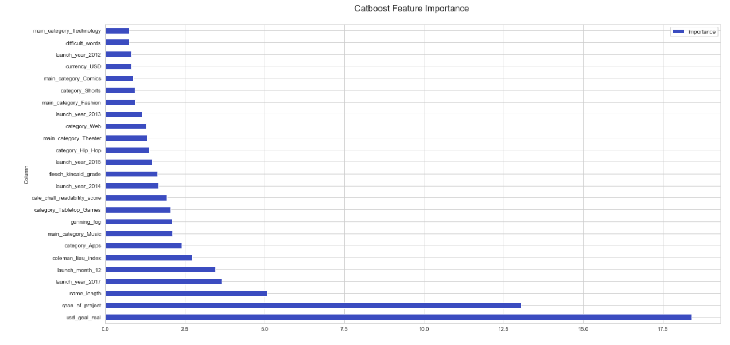
CatBoost Top 25 Features
Notes:
Default Importance ranking for Catboost is PredictionValuesChange. For each feature, the table shows the average amount the prediction changes if the feature value changes. The bigger the value of the importance the bigger on average is the change to the prediction value, if this feature is changed.
Feature importance values are normalized so that the sum of importances of all features is equal to 100 (only top 25 are shown here and there are a total of 237 features). This is possible because the values of these importances are always non-negative.

Slide 4
Catboost Top 25 Features
Goal of Campaign (usd_goal_real) tops the list - 18.39
Second place: Duration of Campaign (span_of_project) -13.04
TextStat variables (measuring “quality of title) and Name_length
Categories & Sub-Categories
Launch date

Slide 5
Title Manipulation
One of the easier elements of a campaign to control
Coleman Liau Index, Gunning Fog, Flesch Kincaid Grade - “grade formulas” in that a score of 6 means that a sixth grader would be able to read the document.
Dale Chall Readability Score - calculates grade in different way from other tests by utilizing lookup table of most commonly used 3000 English words
Difficult Words - defined as those words which do not belong to a predefined list of common words
Name_length - number of words in title

Slide 6
Categories and Sub-Categories
Main Categories (in order): Music, Theatre, Fashion, Comics, Technology
Music was also most common main category in dataset
15 total main categories in dataset
Surprising that Games and Film & Video (second most common) did not make Top 25
Sub-Categories (in order): Apps, Tabletop Games, Hip-Hop, Web, Shorts
159 sub-categories in total

Slide 7
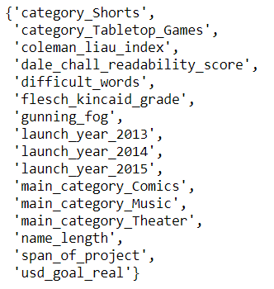
Overlap between Top Classifiers
16 total items that appear in all three classifier top 25 feature lists
5 TextStat variables plus name_lengh
usd_goal_real and span_of_project each in the top 5 for all three individual classifier models

Slide 8
Conclusion
Goal of project is the most important
Duration of project consistent second place
Have someone proofread your title
Main Categories: Music, Comics, Dance
Sub-Categories: Shorts & Tabletop Games
In the future, data on users creating campaigns could provide more insight

